Slide 1

DSIM Project
Mono/Bi Dimensional Signal Processing and GAN
Vittorio Haardt (853268)
Luca Porcelli (853189)
(Group LV)
Università degli studi di Milano-Bicocca
20 Feb 2024

Slide 2
Outline
Mono-Dimensional Signal Classification
Bi-Dimensional Signal Classification
StarGAN Model
Digital Signal and Image Management
2 31

Slide 3
0.1 Data
Emotion classification and generation from different type of signals.
Modo Dimensional
~12,000 audio file
7 categories
Bi Dimensional
~14,000 images
5 categories
GAN
Same dataset used in bi-dimensional signal classification
Digital Signal and Image Management
3 31

Slide 4
Outline: Mono-Dimensional Signal Classification
Mono-Dimensional Signal Classification
Data and Preprocessing
Classification
Results
Bi-Dimensional Signal Classification
StarGAN
Digital Signal and Image Management
4 31

Slide 5
1.1 Data and Preprocessing
Data from 4 different datasets [1] can make the results more generalizable.
Many emotion classification datasets are limited to speech made by the same actors pronouncing the same phrases. Unifying different datasets can make the model more generalizable.
Class
Unbalanced class distribution was addressed through undersampling to match the less numerous class.
~ 4,200 records
Angry - (16.7%)
Happy - (16.46%)
Sad - (16.35%)
Neutral - (14.26%)
Fearful - (16.46%)
Disgusted - (15.03%)
Surprised - (4.74%)
[1] Audio Emotions, Uldis Valinis (https://www.kaggle.com/datasets/uldisvalainis/audio-emotions)
Digital Signal and Image Management
5 31

Slide 6
1.1 Data and Preprocessing
Since the audio came from different dataset, the sound rate was different.
The length (sound data/sound rate) was also different different.
Need to have a standard audio format, used also for deployment.
Preprocessing
Uniform sound rate (48 kHz)
Padding for the same length (~ 2 sec.) [Avg of sound data length]
Digital Signal and Image Management
6 31

Slide 7
1.2 Classification
Task: Compare the performance of two feature set on audio classification.
Features
Set of features [2][3]
MFCC
Feature selection strategy: implemented to remove noise and aid classification.
Evaluation
Machine Learning Architectures
Deep Learning Architectures
Evaluated using Accuracy
[2] Breebaart, Jeroen, and Martin F. McKinney. "Features for audio classification." Algorithms in Ambient Intelligence.»
[3] Liu, Zhu, Yao Wang, and Tsuhan Chen. "Audio feature extraction and analysis for scene segmentation and classification."
Digital Signal and Image Management
7 31

Slide 8
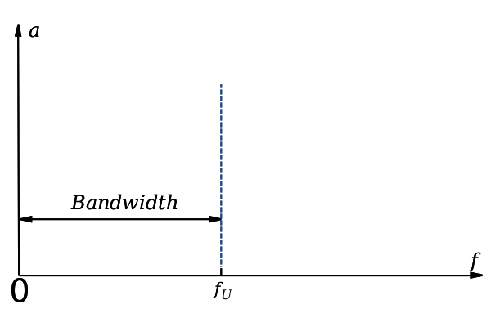
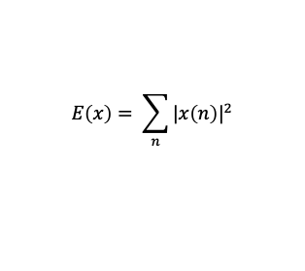
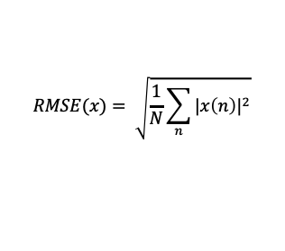
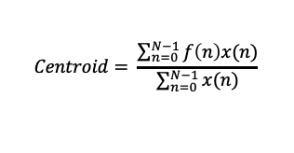
1.2 Classification: features’ set
Spectral Centroid
RMS
$$Centroid= \frac{\sum_{n=0}^{N−1}{f\left(n\right)x(n)}}{\sum_{n=0}^{N−1}{x(n)}}$$
$$RMSE(x)= \sqrt{\frac{1}{N}\sum_{n}{{|x\left(n\right)|}^{2}}}$$
Bandwidth
Energy
$$E\left(x\right)= \sum_{n}{{|x\left(n\right)|}^{2}}$$
Digital Signal and Image Management
8 31

Slide 9
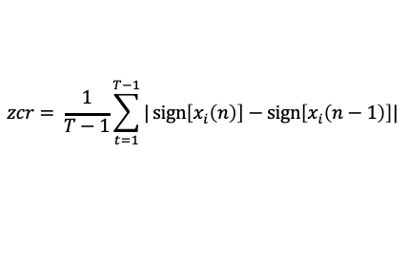
1.2 Classification: features’ set
Spectrum magnitude
Zero Crossing Rate
The Magnitude Spectrum of a signal describes a signal using frequency and amplitude
$$zcr= \frac{1}{T−1}\sum_{t=1}^{T−1}{|\operatorname{sign}\left[x_{i}\left(n\right)\right]−\operatorname{sign}\left[x_{i}\left(n−1\right)\right]|}$$
Spectral roll off
Center frequency for a spectrogram bin such that at least roll_percent (0.85) of the energy of the spectrum in this frame is contained in this bin and the bins below.
Digital Signal and Image Management
9 31

Slide 10
1.2 Classification: MFCC
Mel-Frequency Cepstral Coefficients (MFCC) are a feature widely used in speech and audio processing. They represent the short-term power spectrum of a sound and are derived from the human auditory system.
Steps
Take the Fourier trasfomation of a signal.
Map the powers of the spectrum obtained above onto the mel scale, using overlapping windows.
Take the logs of the powers at each of the mel frequencies.
Take the discrete cosene trasformation of the list of mel log powers, as if it were a signal.
The MFCCs are the amplitudes of the resulting spectrum.
13 MFCC coefficients for each frame of the audio signal
Digital Signal and Image Management
10 31
Notes:
Slide extra con come sono state scelte le soglie e su come funzionano le misure scelte

Slide 11
1.2 Classification: ML models
Boruta method for feature selection and 10 fold cross validated of the training set.
Random Forest
Max depth: [None, 10 , 20]
N estimetors: [50, 100, 200, 300]
K-NN
N neighbors: [3, 5, 7, 10]
p: [1,2]
SVM
C: [100, 500, 1000]
Gamma: [0.005, 0.01, 0.1, 0.5, 1.0]
Digital Signal and Image Management
11 31
Notes:
Slide extra con come sono state scelte le soglie e su come funzionano le misure scelte

Slide 12
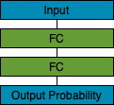
1.2 Classification: DL models
We tried three architectures from scratch to compare the performance.
All the networks started with random weight, and no transfer learning was involved.
Validated on 0.2 of the training set.
ANN
Parameters
Epoch = 1000 (early stop)
Batch size = 32
Learning rate = 1e-3
Optimizer = Adam
Decay = 0.8 (every 10 epoch)
Drop out = 0.5 (every fc layer)
Loss function = sparse categorical cross entropy
Digital Signal and Image Management
12 31

Slide 13
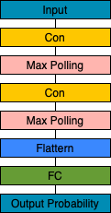
1.2 Classification: DL models
Convolutional neural network should have better performance thanks to the convolutional layers.
CNN
Parameters
Epoch = 1000 (early stop)
Batch size = 32
Learning rate = 1e-4
Optimizer = Adam
Decay = 0.8 (every 10 epoch)
Regularizer = 1e-2
Loss function = sparse categorical cross entropy
Digital Signal and Image Management
13 31

Slide 14
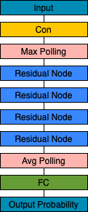
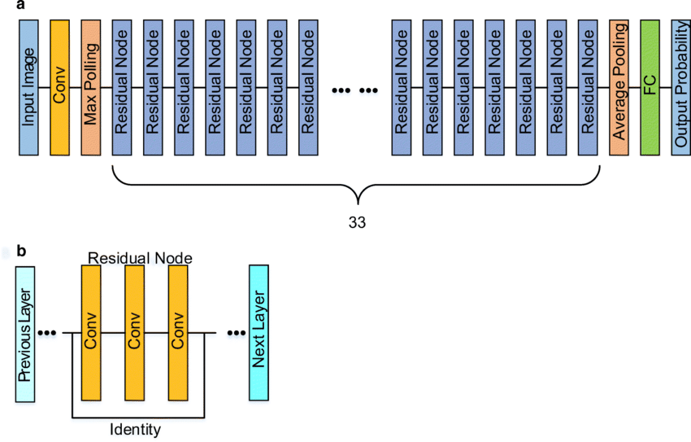
1.2 Classification : DL models
Residual blocks allow the model to learn the difference form identity and output of convolutions.
ResNN
Parameters
Epoch = 1000 (early stop)
Batch size = 32
Learning rate = 1e-4
Optimizer = Adam
Decay = 0.8 (every 10 epoch)
Regularizer = 1e-2
Loss function = sparse categorical cross entropy
Digital Signal and Image Management
14 31

Slide 15
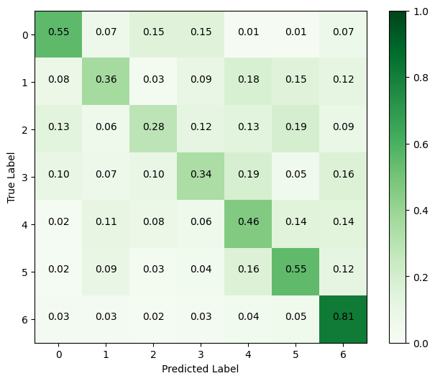
1.3 Results
The feature achieve similar result as the MFCC, the deep learning architecture don’t have a big impact with this sets of features.
 | RF | K-NN | SVM | ANN | CNN | ResNN
Features | 0.478 | 0.443 | 0.502 | 0.450 | 0.432 | 0.455
MFCC | 0.444 | 0.402 | 0.435 | 0.432 | 0.437 | 0.431
The features have in general always better results then the MFCC.
Digital Signal and Image Management
15 31

Slide 16
Outline: Bi-Dimensional Signal Classification
Mono-Dimensional Signal Classification
Bi-Dimensional Signal Classification
Data and Preproccessing
Classification
Results
StarGAN Model
Digital Signal and Image Management
16 31

Slide 17
2.1 Data and Preprocessing
Used a kaggle dataset [4] where the images were collected by scrapping social nets as Facebook and Instagram, scrapping YouTube videos and already available datasets as IMDB and AffectNet.
This may cause some quality issues in the images.
Class
Unbalanced class distribution was addressed through undersampling to match the less numerous class.
~5,500
Angry - (9.2%)
Happy - (26.2%)
Sad - (28.3%)
Neutral - (27.6%)
Surprise - (8.8%)
[4] Facial Emotion Recognition Image Dataset, Sujay Kapadnis (https://www.kaggle.com/datasets/sujaykapadnis/emotion-recognition-dataset)
Digital Signal and Image Management
17 31

Slide 18
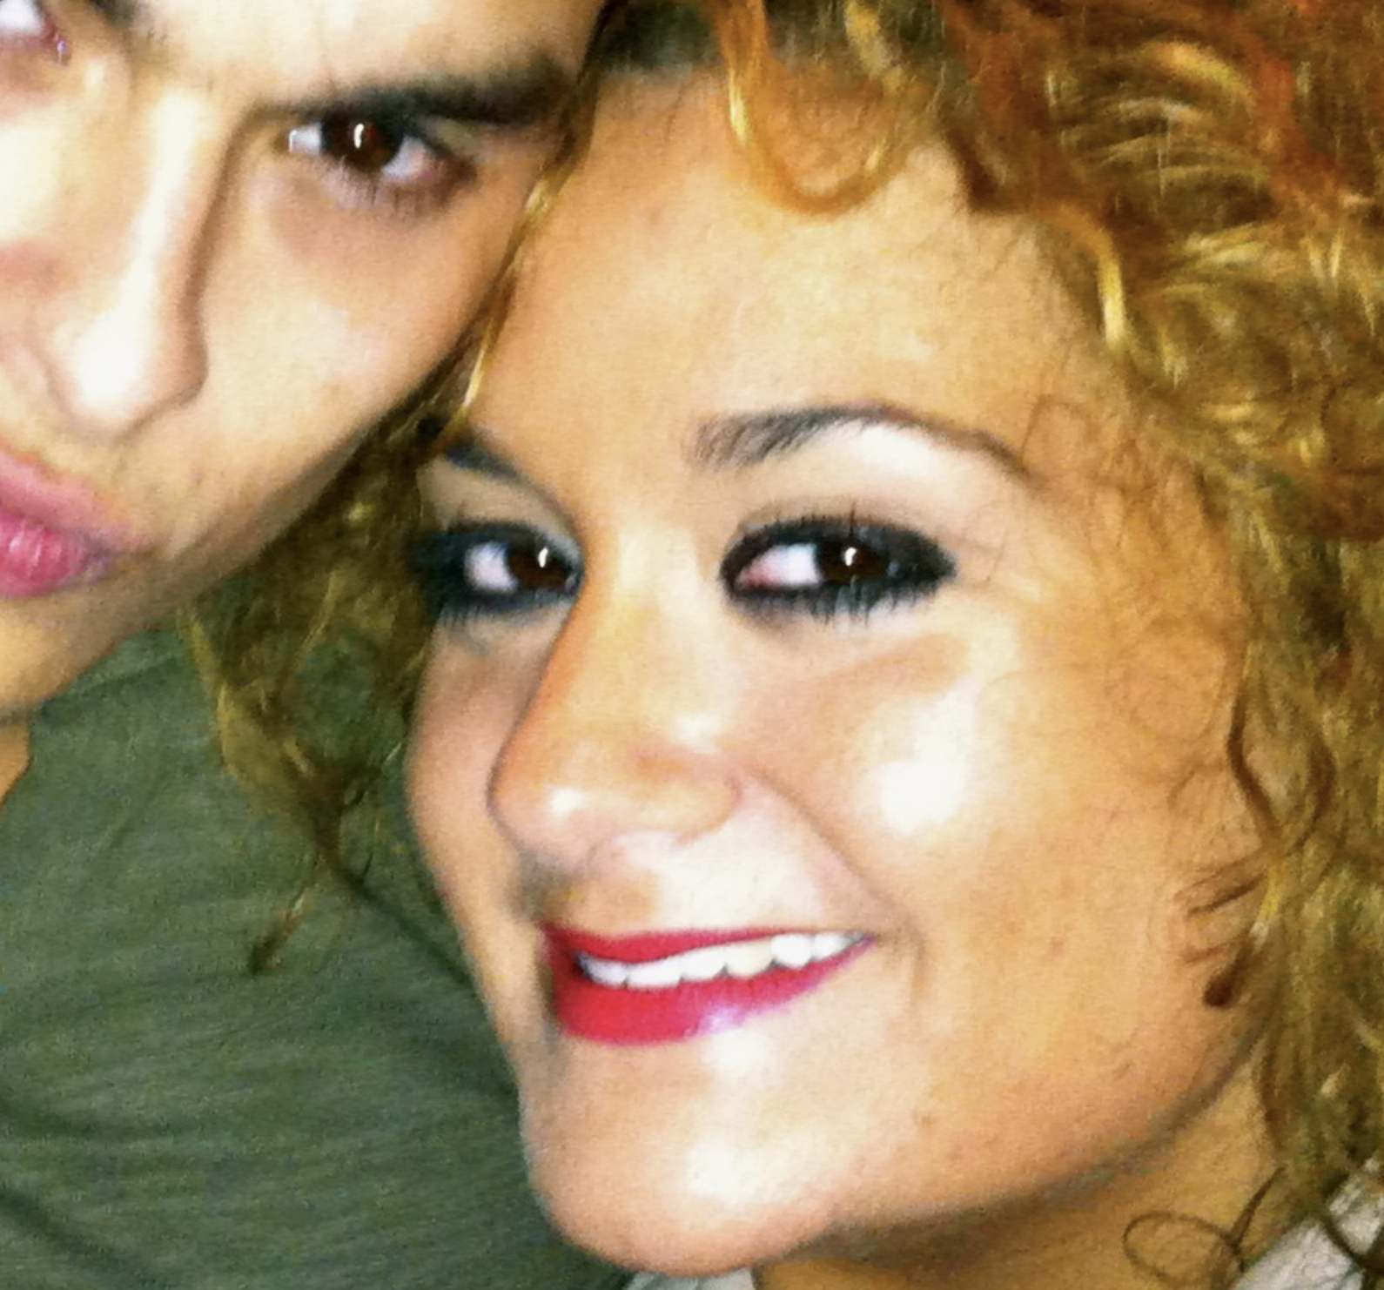
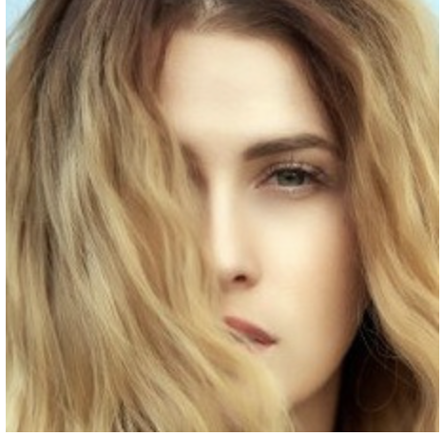

2.1 Data and Preprocessing
Data poses several challenges, such as the presence of multiple faces in the same image, obscured parts, and poor image quality. We have chosen not to tackle these issues, understanding that doing so could negatively impact our performance.
Digital Signal and Image Management
18 31

Slide 19
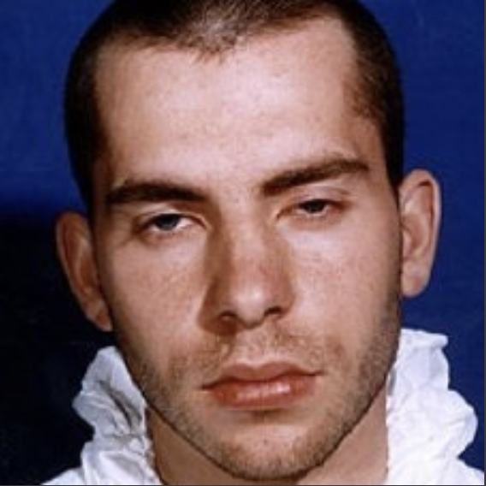

2.1 Data and Preprocessing
We hypothesized that facial emotions could be understood solely by considering the edges of faces.
Therefore, we employed edge extraction on our dataset and trained the classifiers using these processed images as well.
Edge extraction
Image in gray scale
Scharr kernels on both directions (x/y)
Separate application of both kernels
Extraction of vertical and horizontal edges
Chopped to obtain the final image
Digital Signal and Image Management
19 31

Slide 20
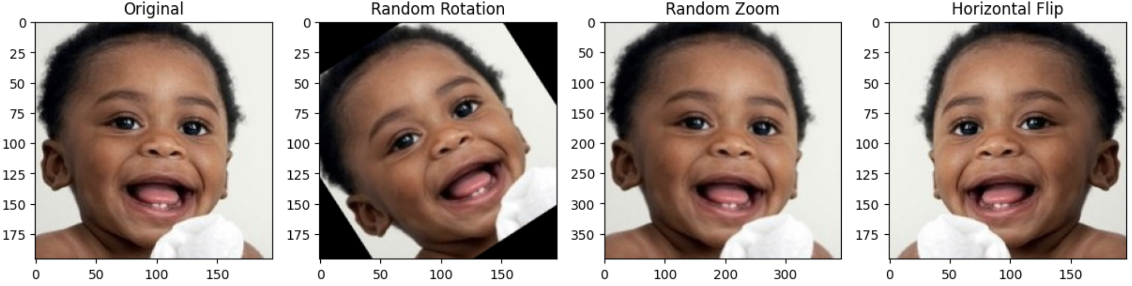
2.2 Classification: Data agumentation
Data augmentation allow to enhance generalizability, expand the data dimensions, and mitigate overfitting.
Strategies
Rotation = 40
Zoom range = 0.2
Horizontal flip
Digital Signal and Image Management
20 31
Notes:
Slide extra con come sono state scelte le soglie e su come funzionano le misure scelte

Slide 21
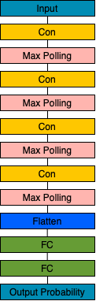
2.2 Classification: CNN
Model built and trained from scratch. Validated on 20% of the training set.
Parameters
Epoch = 50 (early stop)
Batch size = 64
Learning rate = 1e-4
Optimizer = Adam
Decay = 0.5 (Every 10 epoch)
Dropout = 0.25 every fc layer
Loss function = Categorical cross entropy
Digital Signal and Image Management
21 31

Slide 22
2.3 Classification : ResNet50 fine tuning
ResNet50 in fine tuning (ImageNet weights).
Freeze weights to the last convutional block of pretrained models.
Architecture Modify
Parameter
Epoch = 50 (early stop)
Batch size = 64
Learning rate = 1e-3
Optimizer = Adam
Decay = 0.5 (every 10 epoch)
Regularizer = 1E-2 (last layer)
Loss function = Categorical cross entropy
Input layer
Output layer
Input layer (224, 224, 3)
Global average pooling 2D
Dropout 0.3 (to reduce overfitting)
Fully connected layer, with softamax (5)
Tried to unfreeze all the network, assigning a lower learning rate (0.0001) to the layer until the last convolutional block. This greatly improved the performance.
Digital Signal and Image Management
22 31

Slide 23
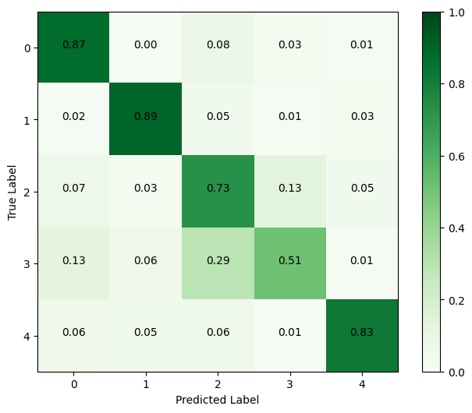
2.3 Results
The unfreezing strategy has proven to be successful. Both RGB and the image with only the edges exhibit similar performance in the best model, affirming that our idea was correct.
 | RGB | Edges
CNN | 0.5632 | 0.5865
ResNet50 (freezed) | 0.6272 | 0.5387
ResNet50 (unfreezed) | 0.7423 | 0.7669
Digital Signal and Image Management
23 31

Slide 24

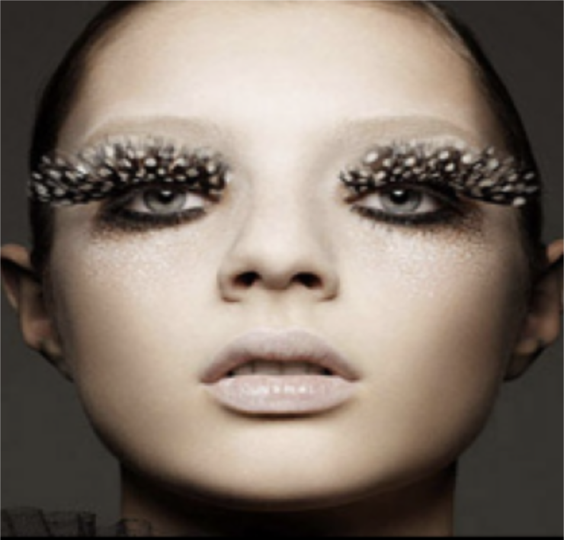
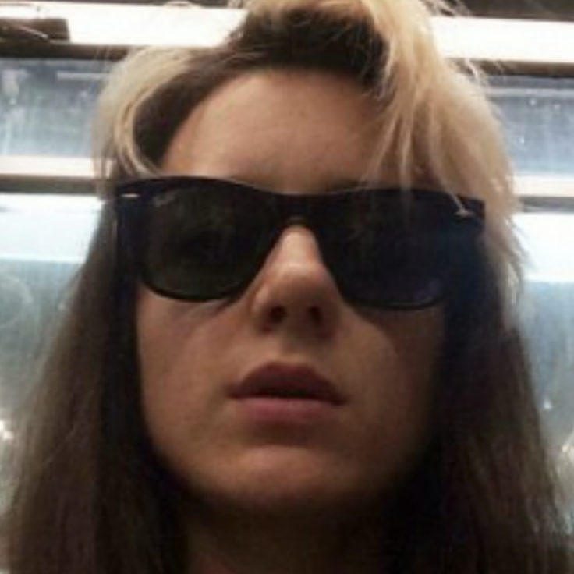
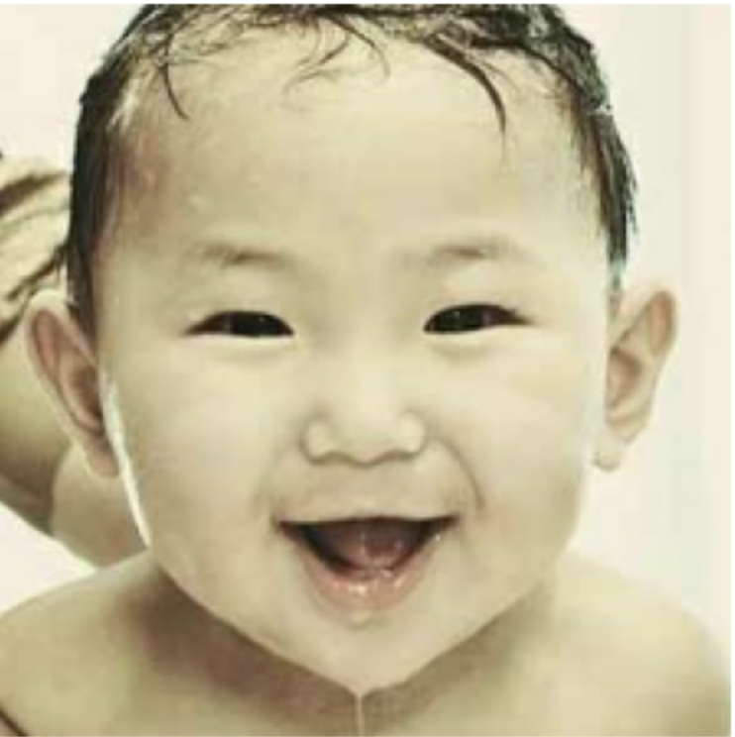
2.1 Results
Some facial features like sunglasses or extreme expressions can lead the model to misinterpret the emotions. Additionally, children are more likely to be misclassified, probably due to their different facial proportions.
Gt: Sad
Pred: Angry
Gt: Neutral
Pred: Angry
Gt: Neutral
Pred: Happy
Gt: Happy
Pred: Angry
Digital Signal and Image Management
24 31

Slide 25
Outline: StarGAN Model
Mono-Dimensional Signal Processing
Bi-Dimensional Signal Processing
StarGAN Model
From CycleGAN to StarGAN
Training
Results
Digital Signal and Image Management
25 31

Slide 26
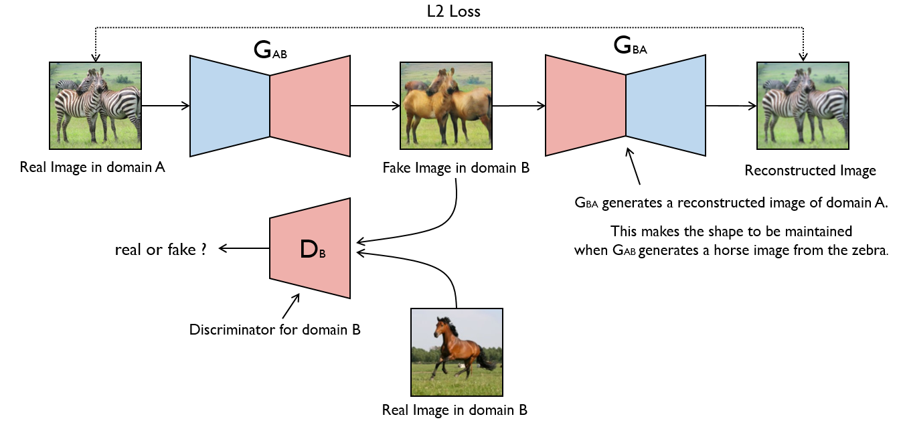
3.1 From CycleGAN to StarGAN
GANs can be applied to the translation of images. The simplest approach train an autoencoder to translate the photo, used for paired image to image translation.
In some other cases all we have in terms of data is two data sets which don't overlap at all.
Cycle GAN
1°Generator: translate the image
Discriminators: real or fake
2°Generator: translated image still looks like the original in some way.
Digital Signal and Image Management
26 31
Notes:
Slide extra con come sono state scelte le soglie e su come funzionano le misure scelte

Slide 27
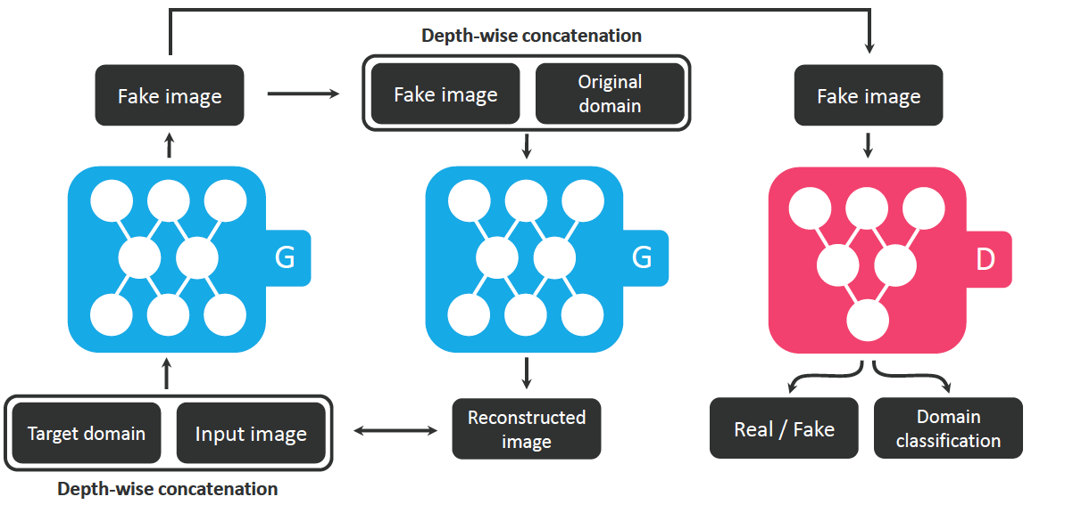
3.1 From Cycle GAN to StarGAN
Standard architectures: 4 generators and 2 discriminator for every pairs.
StargGAN: single generator and discriminator. Use label for a target class (1-hot-vector), appended as an additional channel. Discriminator is now also tasked with outputting a classification.
SrarGAN Learning Objectives
How much the generated image looks like a real image
How much a generated image looks like the target domain in comparison to the target label
Translate it back into the original image, and penalized for differences btw the original and reconstructed images
Digital Signal and Image Management
27 31
Notes:
Slide extra con come sono state scelte le soglie e su come funzionano le misure scelte

Slide 28
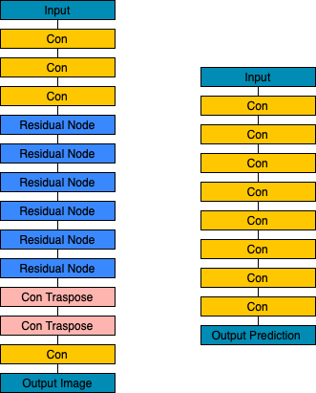
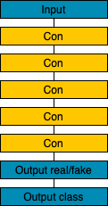
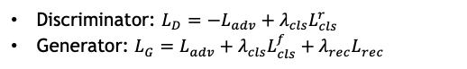
3.2 Training
Generator
Discriminator
StarGAN [5] Discriminator and Generator are trained alternately (5 to 1).
Objective Functions
Discriminator: $L_{D}=−L_{adv}+λ_{cls}L_{cls}^{r}$
Generator: $L_{G}=L_{adv}+λ_{cls}L_{cls}^{f}+λ_{rec}L_{rec}$
Where: $λ_{cls}=1$ and $λ_{rec}=10$
Adversal loss use Wasserstein GAN objective with gradient penality, for stability and higher quality
Training Parameters
200.000 iteration, batch size 16
Lr 0.0001 for first 10 epoch, linerly decay after
[5] Choi, Yunjey, et al. "Stargan: Unified generative adversarial networks for multi-domain image-to-image translation."
Digital Signal and Image Management
28 31

Slide 29
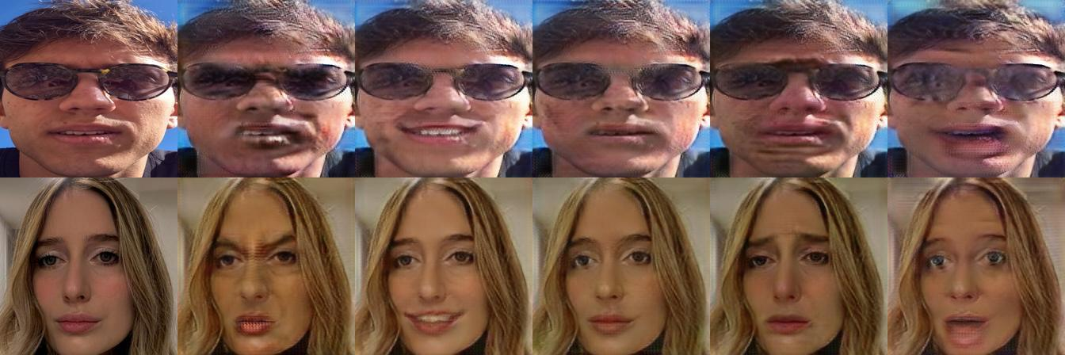
3.4 Results
The outcomes align with expectations. The poorest results, indicated by surprised facial expressions, likely stem from a lack of training images.
 | 😡 | 😁 | 😐 | 😢 | 😳
FID | 66.6 | 40.6 | 45.0 | 47.9 | 73.0
Digital Signal and Image Management
29 31

Slide 30
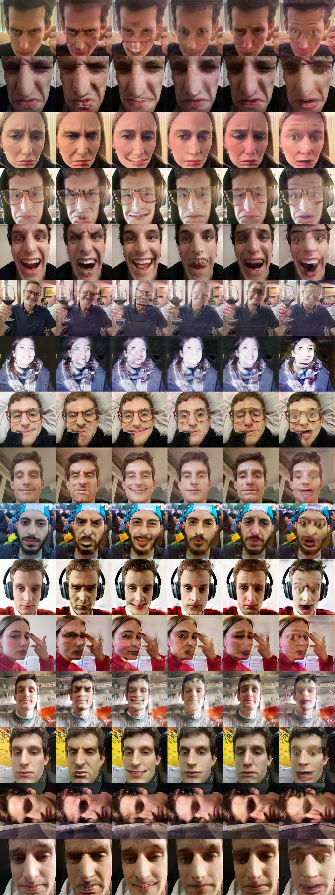
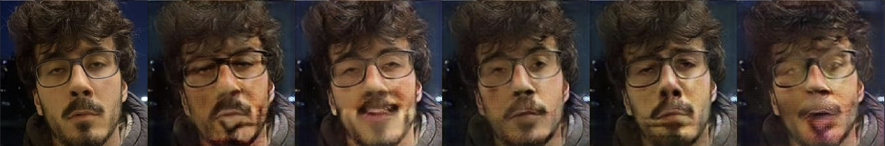
3.4 Results
Problems
Unfavorable outcome due to:
Poor image quality
Extreme expressions
Presence of facial hair and glasses
Profile or sideway
Wider field images
Digital Signal and Image Management
30 31

Slide 31
Thanks for the attention! Questions?

Slide 32
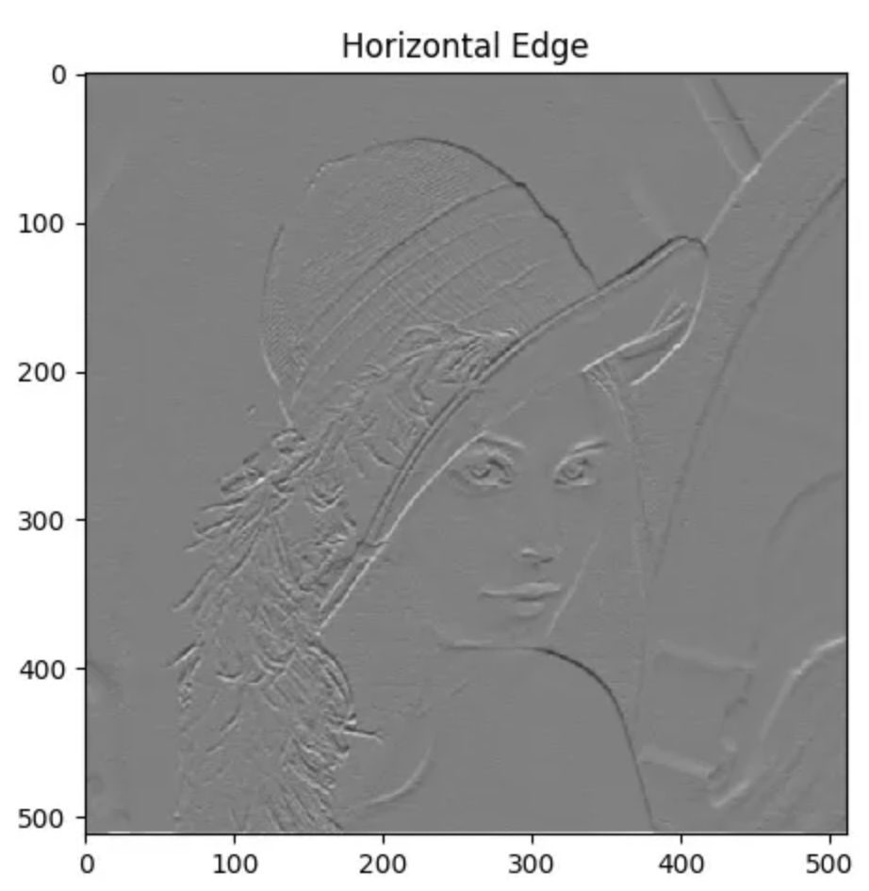
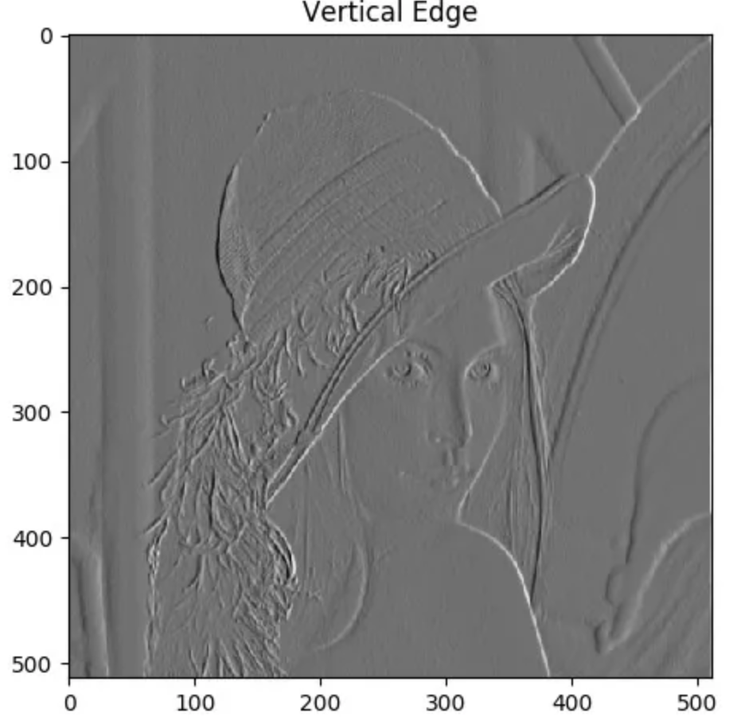
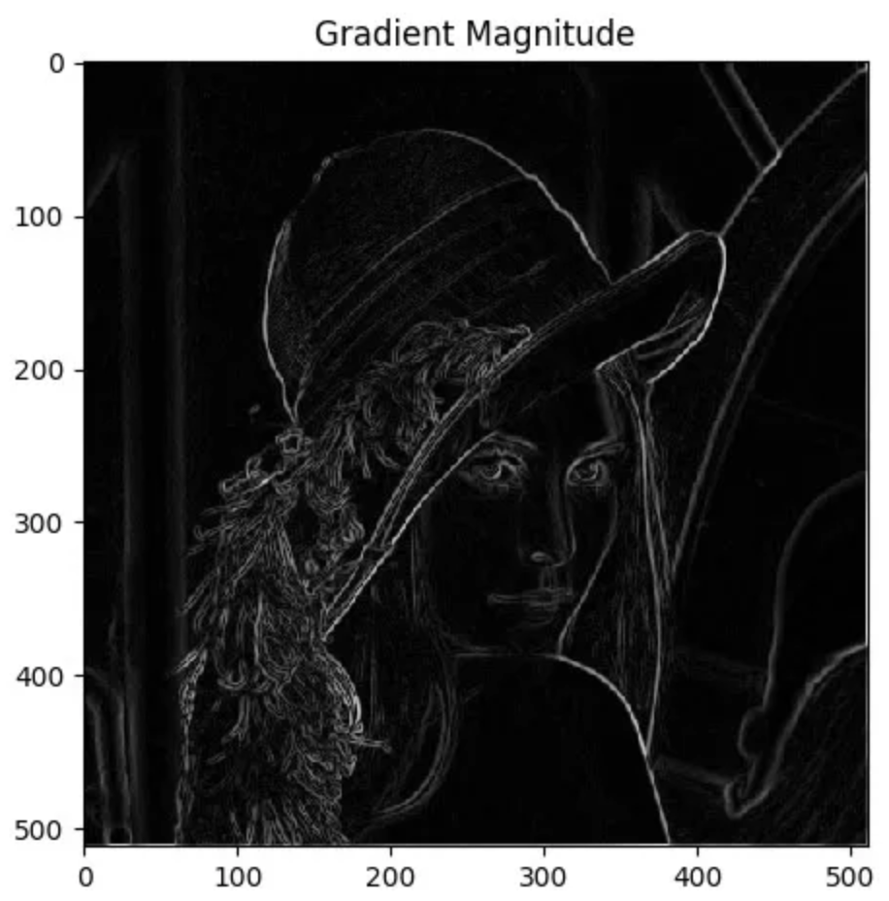
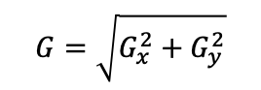
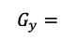
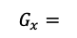
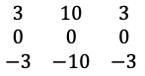
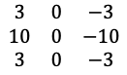
Edge Detection
The Scharr kernel is designed to provide better rotational symmetry and accuracy compared to other kernels like Sobel.
Kernels
$$\begin{matrix}3 & 0 & −3 \\ 10 & 0 & −10 \\ 3 & 0 & −3\end{matrix}$$
$$G_{x}=$$
$$G=\sqrt{G_{x}^{2}+G_{y}^{2}}$$
$$\begin{matrix}3 & 10 & 3 \\ 0 & 0 & 0 \\ −3 & −10 & −3\end{matrix}$$
$$G_{y}=$$
Normalized btw 0 and 255
Digital Signal and Image Management
extra

Slide 33
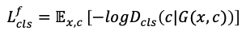
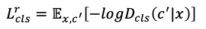
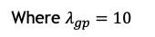
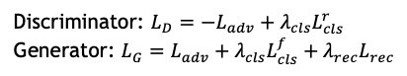
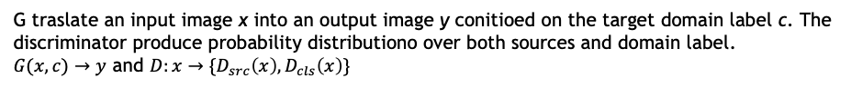
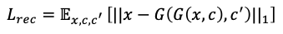
StarGAN Loss Functions
G traslate an input image x into an output image y conitioed on the target domain label c. The discriminator produce probability distributiono over both sources and domain label.
$G(x,c)→y$ and $D:x→\{D_{src}\left(x\right), D_{cls}\left(x\right)\}$
Steps
Steps
Discriminator: $L_{D}=−L_{adv}+λ_{cls}L_{cls}^{r}$
Generator: $L_{G}=L_{adv}+λ_{cls}L_{cls}^{f}+λ_{rec}L_{rec}$
$$L_{adv}=𝔼_{x }\left[logD_{src}(x)\right]+E_{x,c}[log⁡(1−D_{src}\left(G\left(x,c\right)\right)]$$
$$L_{cls}^{r}=𝔼_{x,c^{′}}\left[−logD_{cls}\left(c^{′}|x\right)\right]$$
$$L_{cls}^{f}=𝔼_{x,c }\left[−logD_{cls}\left(c|G(x,c)\right)\right]$$
$$L_{rec}=𝔼_{x,c,c^{′} }\left[||x−G\left(G\left(x,c\right),c^{′}\right)||_{1}\right]$$
WGAN objective with gradient penalty
$$L_{adv}=𝔼\left[D_{src}\left(x\right)\right]−𝔼_{x,c}\left[D_{src}\left(G(x,c\right))\right]−λ_{gp}𝔼_{\hat{x}}\left[(|\left|{∇_{\hat{x}}D}_{src}\left(\hat{x}\right)\right||_{2}−1)^{2}\right]$$
Where $λ_{gp}=10$
Digital Signal and Image Management
extra
Notes:
Slide extra con come sono state scelte le soglie e su come funzionano le misure scelte

Slide 34
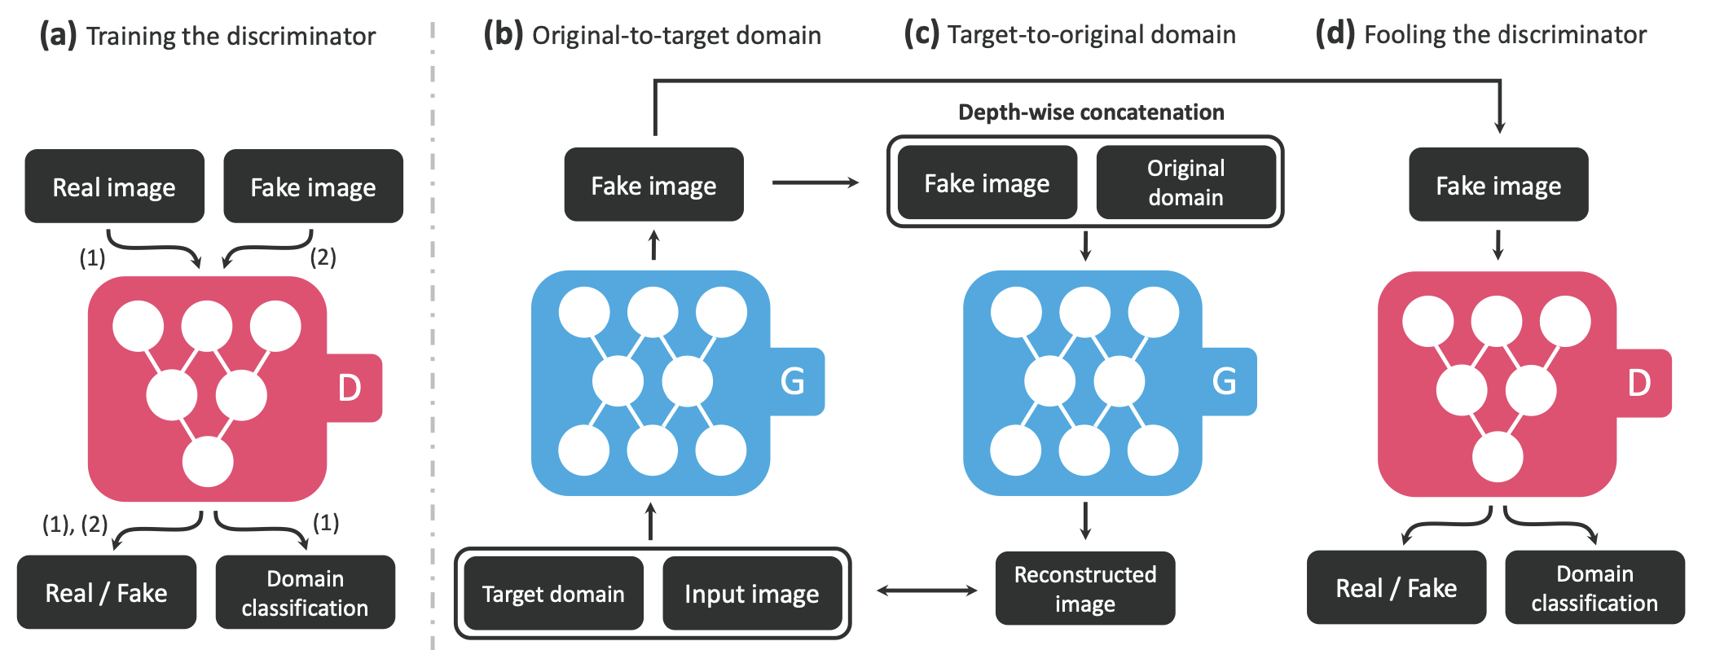
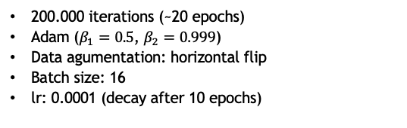
StarGAN Training
D learns to classify real and fake images and classify the real image corresponding domain
G takes in as input both the image and target domain label and generates an fake image.
G reconstruct the original image from the fake image given the original domain label.
G trie to fool D
Parameters
200.000 iterations (~20 epochs)
Adam ($β_{1}=0.5$, $β_{2}=0.999$)
Data agumentation: horizontal flip
Batch size: 16
lr: 0.0001 (decay after 10 epochs)
Digital Signal and Image Management
extra
Notes:
Slide extra con come sono state scelte le soglie e su come funzionano le misure scelte

Slide 35
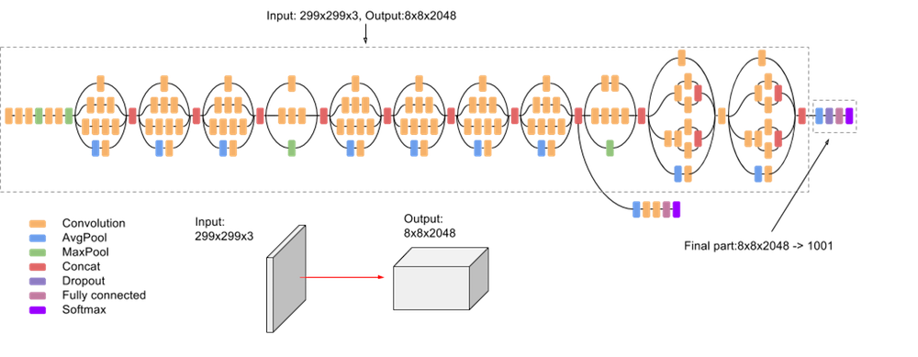
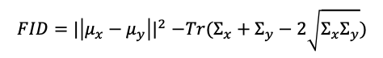
Fréchet Inception Distance
Assess the quality of images created by a generative model.
Unlike Inception Score (IS), which evaluates only the distribution of generated images, the FID compares the distribution of generated images with the distribution of a set of real images.
Steps
Inception V3 (ImageNet) to extract features.
Mean and covariance matrix of the features in each image.
Pre procces the image
Extract feature representations
Calculate statistics
Compute the Fréchet distance
Obtain the FID
Formula
$$FID{=|\left|μ_{x}−μ_{y}\right||}^{2}−Tr(Σ_{x}+Σ_{y}−2\sqrt{Σ_{x}Σ_{y}})$$
Digital Signal and Image Management
extra
Notes:
Slide extra con come sono state scelte le soglie e su come funzionano le misure scelte

